Slide 1


AI-Based Anomaly Detection for Enhanced Performance in Low-Voltage Distribution Networks
Session: AI in Practice – Part 2
Klemen Nagode, Ph.D. – Project Manager
18-20 November 2025
Bilbao, Spain

Slide 2
Company profile
Outline of problem
Agenda
–
Development of algorithm for fault identification
Results – practical examples of anomaly detection
Opentunity project – modules providing services
Conclusion

Slide 3
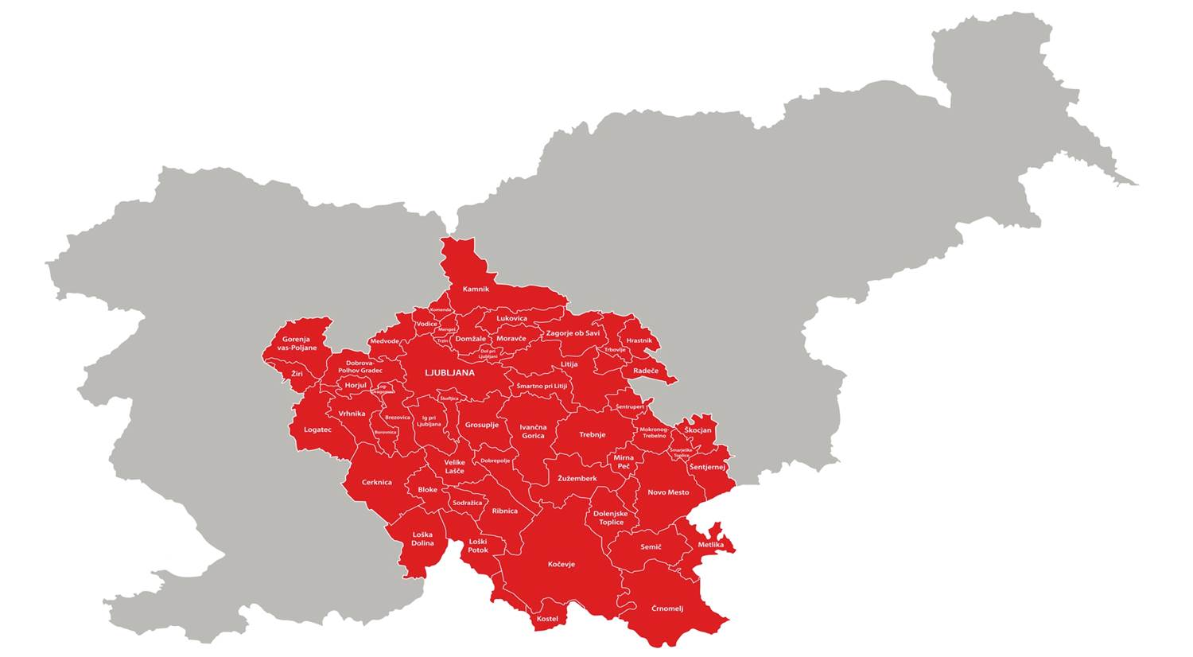
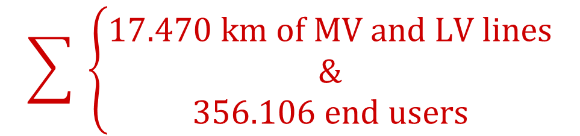
Elektro Ljubljana d.d.
The largest
electricity distribution
network in Slovenia
–
5 distribution units
Distribution area of Elektro Ljubljana
Ljubljana City DU
Ljubljana Environs DU
Novo mesto DU
Trbovlje DU
Kočevje DU
$$\sum{ \left\{\begin{matrix}17.470 km of MV and LV lines \\ \& \\ 356.106 end users\end{matrix}\right.}$$

Slide 4
DETERMINING ESSENTIAL DATA SETS
Offline: metering system, planned and unplanned events from SCADA system (control centre)
Real-time: ADMS SCADA data from HV and MV, on LV only load-flow and state-estimation, data from protection relays,…
Outline of problem
–
Fault localization in highly-branched LV network with a large amount of data
GOAL: A long-term research effort enabling early fault identification, predictive maintenance, and enhanced network reliability.

Slide 5
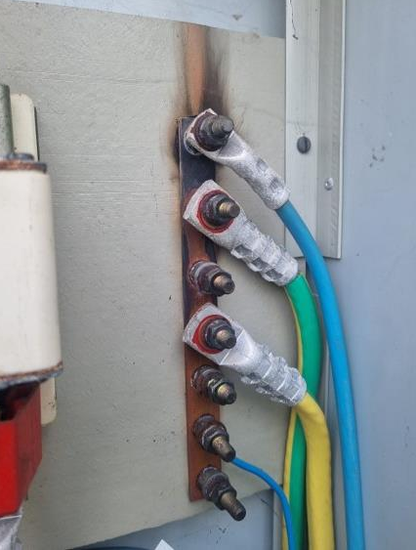
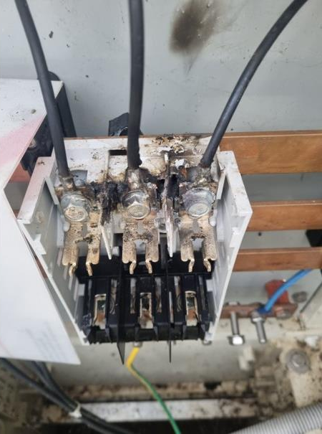
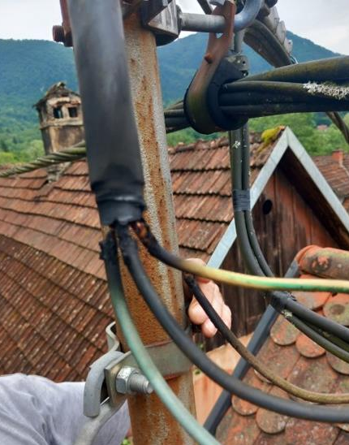
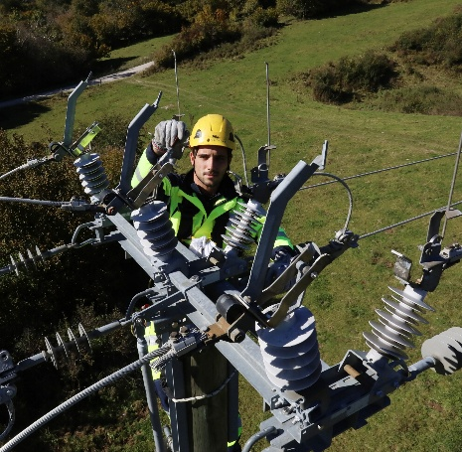
-querry/export data
-coarse filtration
-filtration based on Events on power meters
PREPARATION/DATA ENGINEERINGII
DETERMINATION OF FEATURES
-26 features
-principal component analysis PCA 99 % var (reduction of features 26 → 10 linear comb. of originals + orthogonality)
Development of algorithm
–
Supervised machine learning
Classification
LEARNING & TEST DATA SEPARATION
-90 % DATA → LEARNING (k-fold=3
cross-validation)
ERRORS CONFIRMED/DENIED BY MAINTENANCE TEAMS
-10 % DATA → TEST
MODEL IMPROVEMENT
MODEL LEARNING
-multiple different algoritms
-hyperparameter optimization
DATA VALIDATION
-Accuracy: LEARNING & TEST DATA
-Confusion matrix
-ROC curve
INFORMING MAINTENANCE TEAMS
ON-SITE
INSPECTION
5 distribution units

Slide 6
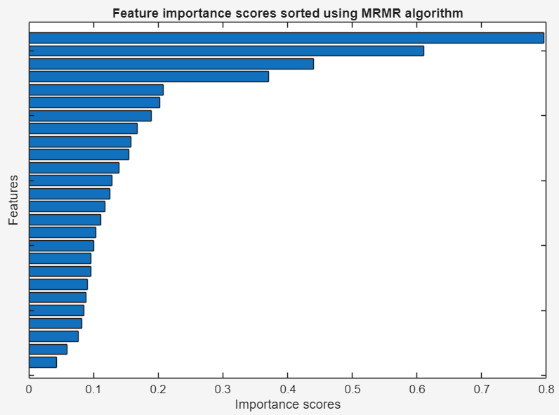
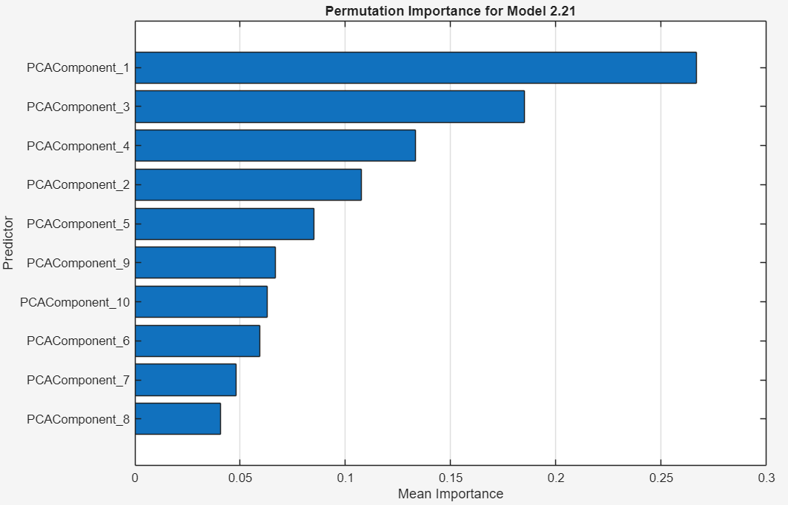
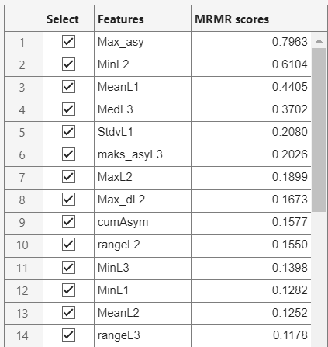


Features calculation, normalization & PCA
determined features iteratively evaluated by different criterions:
minimum redundancy maximum relevance (MRMR)
Development of algorithm
–
weighted kNN
Euclidean distance metric
Number of neighbours k=10
Inverse-squared distance weight w
univariate feature ranking (chi-square test)
$$χ^{2}$$
analysis of variances (ANOVA)
2-step normalization:
weighted kNN (with PCA var=99%)
robust normalization (median & interquartile range)
handling outliers
min-max scaling (transforms data in specific range)
PCA:
orthogonal linear transformation
$$PCA={(M}_{features}−μ)∙C$$
eigenvectors of features‘ covariance matrix

Slide 7
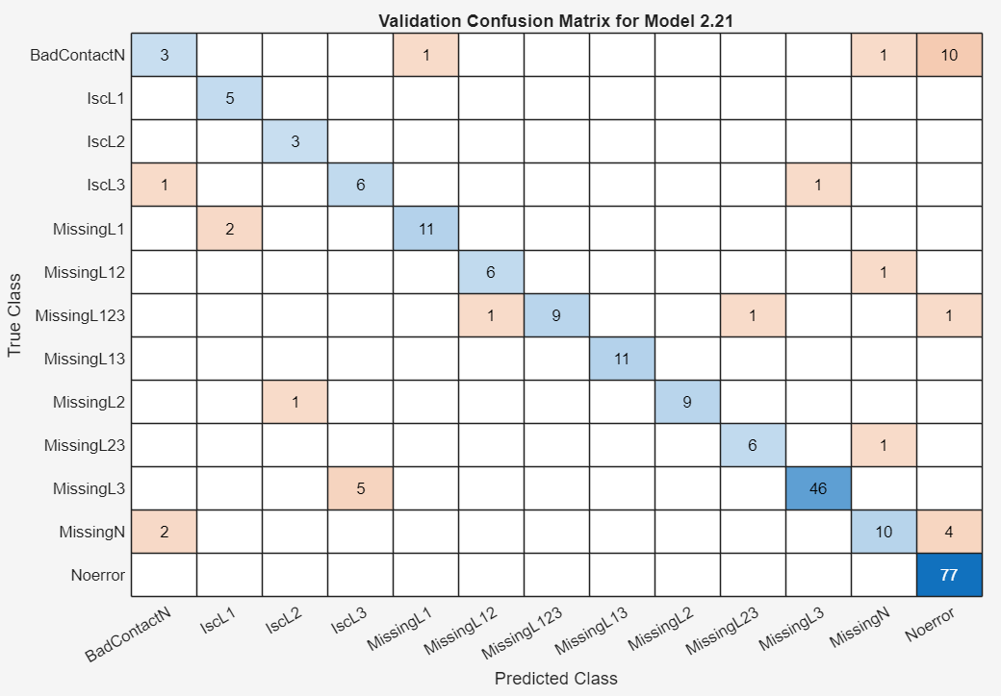
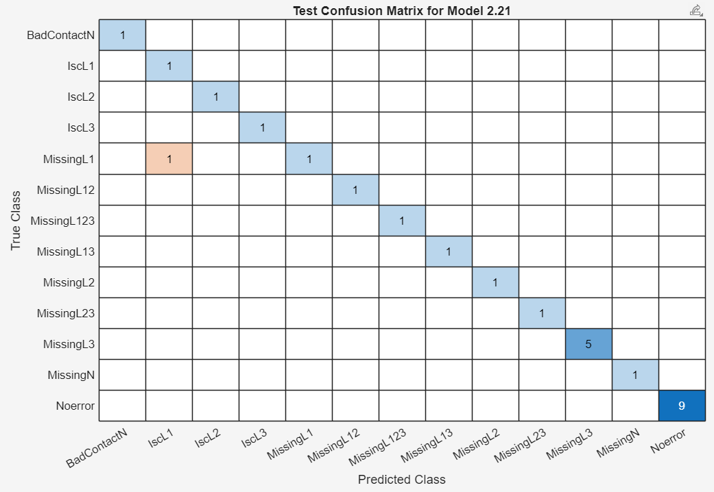
CONFUSION MATRIX
learning data
Development of algorithm
–
weighted kNN
Euclidean distance metric
Number of neighbours k=10
Inverse-squared distance weight w
test data

Slide 8
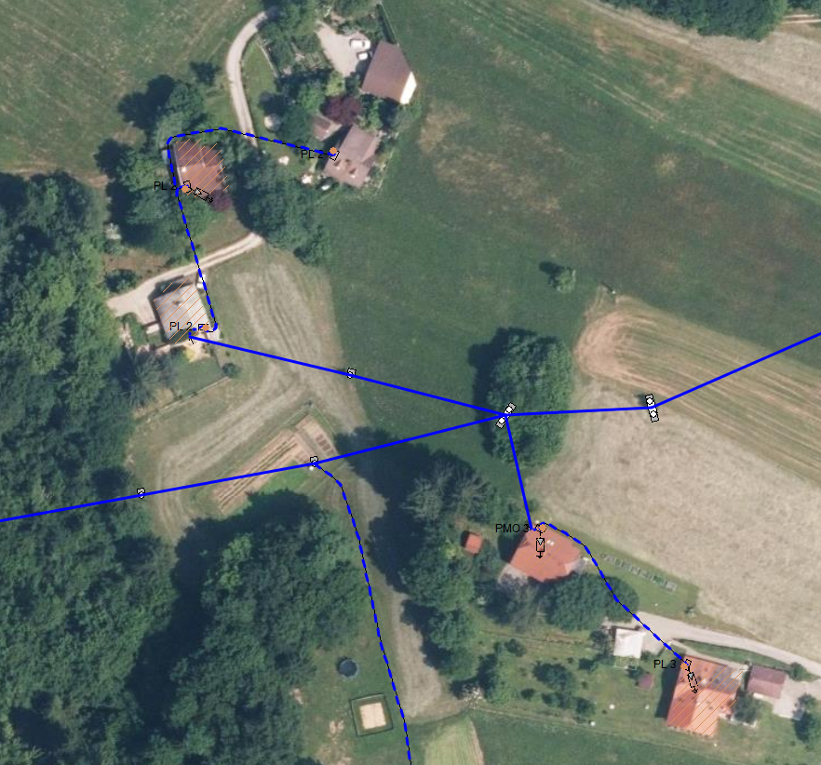
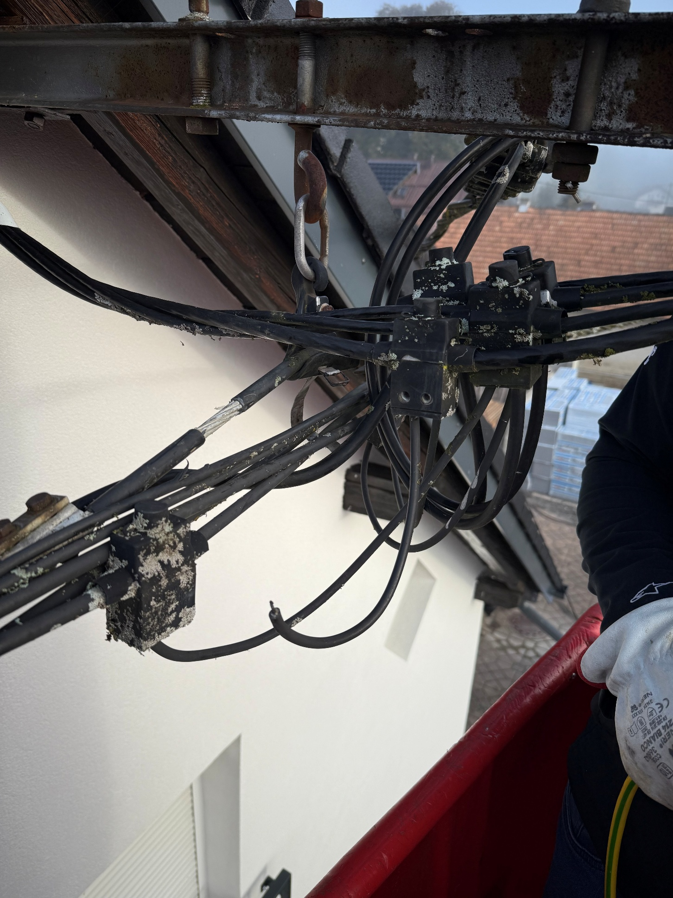
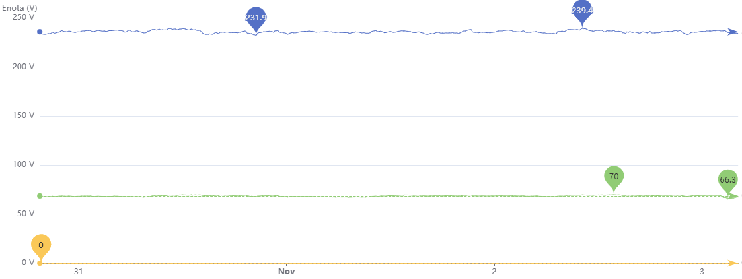
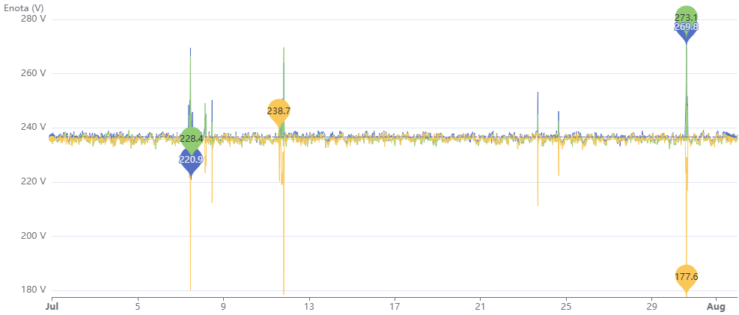
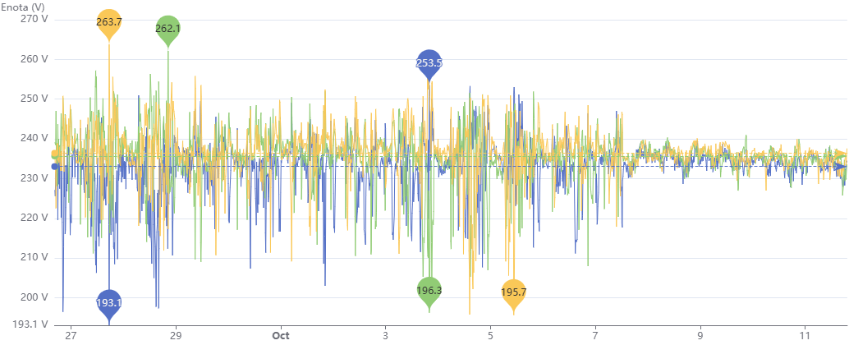
Practical examples of anomaly detection
Kočevje DU
Bad contact
on N line
Results
–
weighted kNN
Euclidean distance metric
Number of neighbours k=10
Inverse-squared distance weight w
FEEDBACK FROM MAINTENANCE GROUP
Bad contact on N line branch terminal,
located on A-wooden pillar
Novo mesto DU
LV 3-phase line
LV 3-phase line
missing voltage: phase 2 and 3
LV 3-phase line
Bad contact
on N line
Bad contact on N line
Bad contact on N line
No error
Bad contact
on N line
LV 3-phase line
Bad contact
on N line

Slide 9
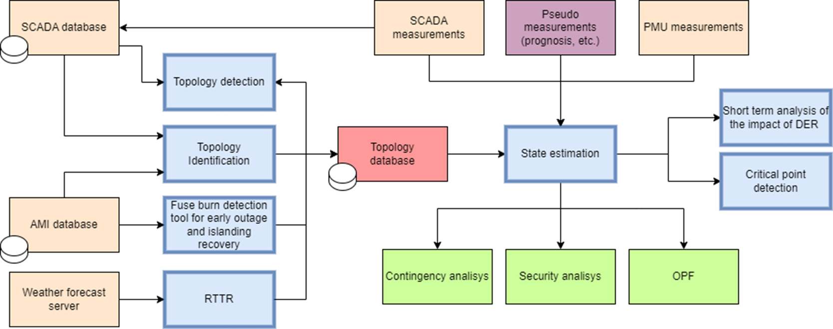

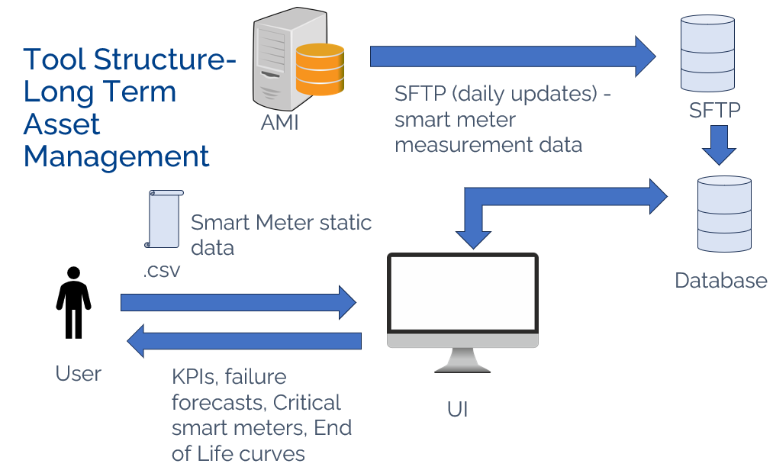

modules providing services and technologies for grid operators
1. Methodology to ensure interoperability and integration of TSO/DSO available infrastructure into software platforms
2. Upgrading topology identification and state estimation
Low-cost Real-Time thermal rating
Advanced Asset Management
Long-Term & Short-Term
Network Planning and Investment deferral from optimal use of flexibility

Slide 10
Advantages of AI-based methodology: setting nonlinear boundaries between classes, fast prediction speed, on-line learning on new data → worthwhile use in detecting faults in the LV network
Conclusion
–
The greatest obstacle: determination which features have highest impact on machine learning performance (classification)
Early involvement of maintenance groups helped us with feedback error verification and further co-creation of AI-based anomaly detection
Currently, development is towards automating the entire AI framework on LV distribution network and integration with other systems
AI-based anomaly detection helps operation and maintenance teams to predictive troubleshooting and enhancing low voltage network reliability

