Slide 1






DESIGN AND EVALUATION OF AN INTEGRATED FLEXIBILITY MARKET FOR TSO–DSO COORDINATION:
INSIGHTS FROM THE OPENTUNITY PILOT IN GREECE
Authors:
Georgia Eirini Lazaridou (HEDNO)*, Dimitris Melissaris (IPTO), Ilias Palaiologou (HEDNO),
Serafeim Panidis (IPTO), Vasileios Boglou (HEDNO), Filippos Rigas (IPTO),
Gesa Milzer (NODES), Svein Jørgen Sønning (NODES)

Slide 2



Current Status & Motivation
European level
Climate change.
Establishment of rules aimed to increase RES percentage in the energy mix (Paris Agreement, RED, REPowerEU ).
Greece
Follows European objectives.
Aim of reach 19 GW of RES capacity by 2030.
Challenges
  Gradual phase out of conventional centralized power plants.
  Reorchestration of power systems → Distribution connected assets should provide ancillary services.
  DSO has a more active role.
  DSO – TSO coordination is required.
Motivation
How must DSO and TSO coordinate for an optimal use of flexibility from assets connected at the DSO grid ?
Renewable Energy Grid Integration Week 2025
24th International Wind & Solar Integration Workshop
This project has received funding from the European Union’s Horizon programme under the Grant Agreement No. 101096333

Slide 3



Relevant Work
5 distinct TSO–DSO interaction schemes for ancillary services procurement.
Integrated Flexibility Market Model: TSOs, DSOs, and commercial market parties to procure and trade flexibility in a shared market environment.
Integrated Local Flexibility Market (LFM).
DSO, TSO and FSPs operate in one market.
Flexibility available upstream from assets connected at DSO grid.
Simultaneous activation → Conflicts, grid issues.
Aim
To define an effective coordination framework and coordination tools for the Greek Pilot in OPENTUNITY.
Pilot location: Markopoulo area, southwest of Athens.
Renewable Energy Grid Integration Week 2025
24th International Wind & Solar Integration Workshop
This project has received funding from the European Union’s Horizon programme under the Grant Agreement No. 101096333

Slide 4
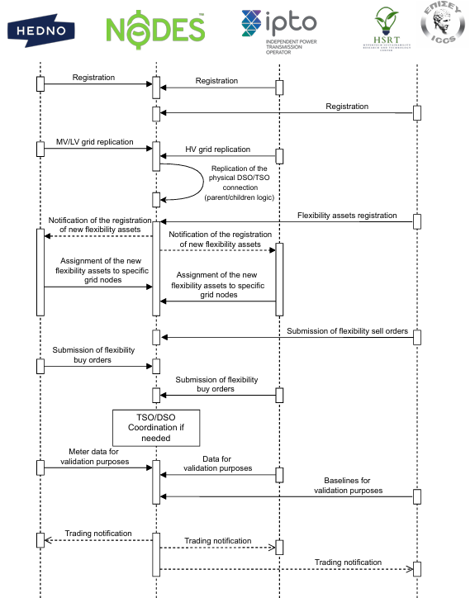
Market Setup
Market Participants and Roles
DSO
Flexibility buyer
Local congestion
FMO
Platform provider
Coordination tools provider
TSO
Flexibility buyer
Balancing services
FSPs
Deliver flexibility based on contracts
Renewable Energy Grid Integration Week 2025
24th International Wind & Solar Integration Workshop
This project has received funding from the European Union’s Horizon programme under the Grant Agreement No. 101096333

Slide 5
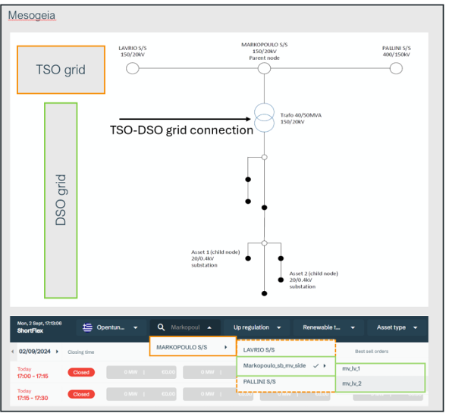
Market Setup
Grid Replication
Grid replication using hierarchical parent–child model.
“Digital” connection of TSO and DSO grid.
Grid assets: HV/MV substation, MV/LV substations, distribution lines.
TSO – DSO grid connection: Markopoulo HV/MV substation.
Renewable Energy Grid Integration Week 2025
24th International Wind & Solar Integration Workshop
This project has received funding from the European Union’s Horizon programme under the Grant Agreement No. 101096333

Slide 6
Market Setup
Flexibility Assets Replication
FSPs: provide Meterpoint ID, asset characteristics, and geographical location.
SOs: validation, assignment to specific grid node.
Parent – child logic
Flexibility offers from assets connected at the LV level can be activated at higher grid levels, including the TSO.
Unified market environment: both SOs procure flexibility across voltage levels from the same assets.
Renewable Energy Grid Integration Week 2025
24th International Wind & Solar Integration Workshop
This project has received funding from the European Union’s Horizon programme under the Grant Agreement No. 101096333

Slide 7
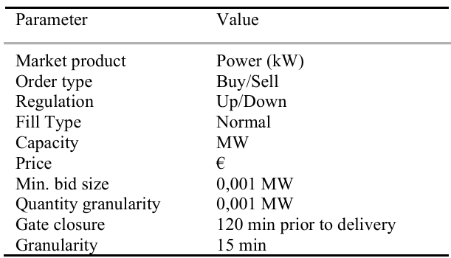
Market Setup
Market Rulebook
Defines market products, bid structure, and the operational timing of market activities.
* No validation and settlement will be tested within this research environment.
Renewable Energy Grid Integration Week 2025
24th International Wind & Solar Integration Workshop
This project has received funding from the European Union’s Horizon programme under the Grant Agreement No. 101096333

Slide 8
Market Setup
Timeline
Sets the chronological order of market operations to integrate with existing processes and/or other markets.
Aligns with National Balancing Market Rulebook and with the Integrated Scheduling Process (ISP).
ISP
Process by IPTO to cover the forecasted generation/demand imbalances and secure the required reserves to maintain the safety of the power system.
Minimizes balancing costs for energy and capacity procurement.
Defines awarded capacity for upward and downward FCR, aFRR, mFRR.
Renewable Energy Grid Integration Week 2025
24th International Wind & Solar Integration Workshop
This project has received funding from the European Union’s Horizon programme under the Grant Agreement No. 101096333

Slide 9
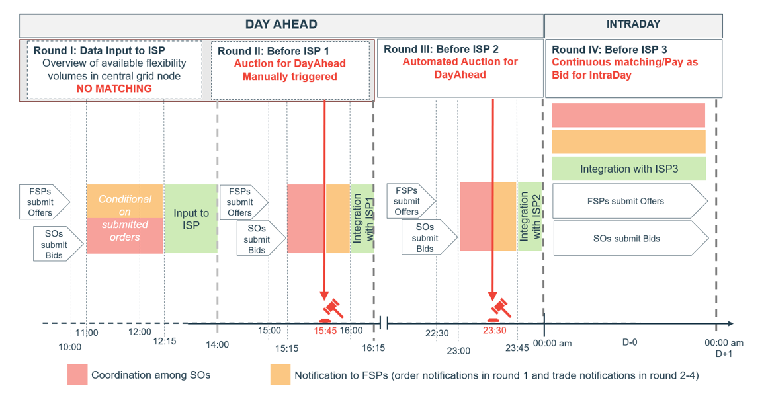
Market Setup
LFM Timeline
Round I: Collect flexibility offers to give SOs an overview of available volumes. Ends at 14:00 D-1. No market clearing – only input for the ISP.
Round II: From 14:00 to 16:15 D-1, FSPs and SOs submit offers. TSO-DSO coordination, followed by a manually triggered auction. Results from the clearing are integrated in ISP1.
Round III: Similar to Round II, automated auction. Finalized in ISP2 before midnight of D-1.
Round IV: Intraday Market with continuous pay-as-bid clearing. FSPs/SOs update offers, TSO-DSO coordination runs continuously.
Renewable Energy Grid Integration Week 2025
24th International Wind & Solar Integration Workshop
This project has received funding from the European Union’s Horizon programme under the Grant Agreement No. 101096333

Slide 10
Market Setup – Market Coordination Tool
Coordinator Role (CR)
Supervisory role, supports market monitoring, facilitates decision making when TSO – DSO Coordination is required.
Represented by both HEDNO and IPTO, and/or NODES.
Dynamic Grid Node Thresholds
Defined by the respective SO at each grid node, ensure flexibility activation remains within safe operational boundaries.
Communicated to the opposite SO at the time of submitting a flexibility request using traffic light system.
Traffic Light System
Flexibility buy orders are validated against the predefined dynamic grid node thresholds.
Activation permitted without restrictions.
May cause grid issues, coordination with hosting SO required.
Beyond threshold, grid violation, request may be rejected.
Market Coordination Messages
Supports real –time dialogue and collaborative decision making.
Help SOs identify appropriate solutions while ensuring that flexibility activations remain within the physical grid constraints.
Renewable Energy Grid Integration Week 2025
24th International Wind & Solar Integration Workshop
This project has received funding from the European Union’s Horizon programme under the Grant Agreement No. 101096333

Slide 11
Flexibility Market Scenarios
Aim: A balance between coordination efforts and outcome.
Scenario 1
Scenario 2
Scenario 3
Three CR configurations/scenarios:
Assignment to the FMO
Joint representation by both SOs
Hybrid configuration involving both the SOs and the FMO.
High Criticality
Low Criticality
Scenarios evaluation:
Problem resolution efficiency
Grid-wide optimality
Implementation complexity
Communication requirements
Renewable Energy Grid Integration Week 2025
24th International Wind & Solar Integration Workshop
This project has received funding from the European Union’s Horizon programme under the Grant Agreement No. 101096333

Slide 12
Scenario 1: Market Operator as the Coordinator Role
Scenario 1
Scenario 2
Scenario 3
Pros
Centralized model with predefined rulebook enables automation.
Automation reduces delays in SO conflict resolution.
Enhanced transparency, simplified coordination.
Cons
Reduced SO involvement may lead to suboptimal activations.
Predefined rules limit adaptability, especially under yellow signals.
Risk of misalignment with real and evolving grid conditions.
High Criticality
Low Criticality
Red light (NODES): rejected
Green light (NODES): accepted
Yellow light (NODES): NODES suggests predefined solutions outlined in the market rulebook.
Renewable Energy Grid Integration Week 2025
24th International Wind & Solar Integration Workshop
This project has received funding from the European Union’s Horizon programme under the Grant Agreement No. 101096333

Slide 13
Scenario 2: Hybrid Approach
Scenario 1
Scenario 2
Scenario 3
Pros
Increased SOs involvement allows expert intervention in complex cases.
Enables negotiation of alternative options (quantities, assets) to satisfy both SOs.
Cons
Negotiation introduces delays.
Conflicts may persist due to diverging SO priorities or objectives.
High Criticality
Low Criticality
Red light (NODES ): rejected
Green light (NODES): accepted
Yellow light (IPTO&HEDNO): act jointly as CR, direct coordination
Renewable Energy Grid Integration Week 2025
24th International Wind & Solar Integration Workshop
This project has received funding from the European Union’s Horizon programme under the Grant Agreement No. 101096333

Slide 14
Scenario 3: Multi-Level Coordination with Prioritization
High-criticality events: Requests at yellow-light thresholds → major impact → handled by SOs.
Low-criticality events: Requests within thresholds → minor impact → handled under FMO oversight.
Scenario 1
Scenario 2
Scenario 3
Pros
Clear distinction between events optimizes SO involvement, by focusing their efforts on grid-critical scenarios.
Reduces delays since SOs take CR in critical cases.
Cons
Dynamic reassignment of the CR role adds complexity.
Requires highly integrated and reliable communication systems.
High Criticality
Low Criticality
Red light (NODES ): rejected
Green light (NODES): accepted
Yellow light (NODES, IPTO&HEDNO): based on event criticality
Renewable Energy Grid Integration Week 2025
24th International Wind & Solar Integration Workshop
This project has received funding from the European Union’s Horizon programme under the Grant Agreement No. 101096333

Slide 15
Conclusions & Future Work
Greek Integrated LFM enables both HEDNO and IPTO to participate in a common market and access the same distributed flexibility resources.
Market Design Objective: ease distribution congestion, support TSO balancing needs, ensure conflict-free activation.
The proposed and implemented innovative coordination tools will be tested through three alternative coordination scenarios.
Future work: evaluate practical performance of scenarios, focusing on speed & efficiency of conflict resolution.
Renewable Energy Grid Integration Week 2025
24th International Wind & Solar Integration Workshop
This project has received funding from the European Union’s Horizon programme under the Grant Agreement No. 101096333

Slide 16



THANK YOU !
https://opentunityproject.eu/
G.Lazaridou@deddie.gr
I.Palaiologou@deddie.gr
V.Boglou@deddie.gr
d.melissaris@admie.gr
s.panidis@admie.gr
f.rigas@admie.gr
Gesa.Milzer@nodesmarket.com
svein.jorgen.sonning@nodesmarket.com
Renewable Energy Grid Integration Week 2025
24th International Wind & Solar Integration Workshop
This project has received funding from the European Union’s Horizon programme under the Grant Agreement No. 101096333

